Slide 1
emoji generation based on textual input using generative adversarial networks
Thesis for LJMU Masters in ML and AI
Darshil Ajay Parekh
27-10-2024
Notes:
Hello All
Today I will be presenting the thesis on emoji… for Masters in

Slide 2
Agenda
Background and Problem Statement
Literature Review
Research Methodology
Results & Discussion
Conclusion and Future Recommendations
Notes:
In this presentation I will be going though…

Slide 3
Background and Problem Statement

Slide 4
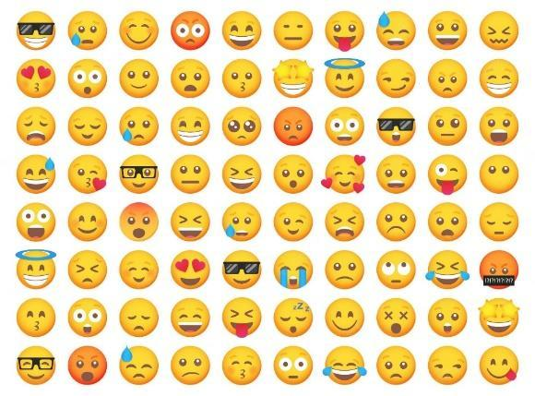
Background
Emoji is a visual representation of human interaction based on human emotions, living beings, objects and symbols. These are in widespread use across the internet such as in textual messaging applications, and social media platforms which are known as informal modes of communication. Below is an image of the most frequently used emojis during informal modes of communication. According to (Kennison et al., 2024) emojis represent faces with human expressions, objects, animals, and actions. Fig 1.1 shows the frequently used emojis during informal communication.
Fig 1.1 Sample emojis used frequently in informal communication (smartprix.com)
Notes:
Most of us use emojis regularly in our day to day lives.
Everyday during informal communication on social media platform like Twitter, WhatsApp, Facebook , Instagram we use emojis to interact with friends and family
Also used in formal communication with colleagues like thumbs up or smile emoji used in an email conversation.
Emoji represent the human emotions, expression and actions
Post reaction with emojis
Feedback form use emojis

Slide 5
Problem Statement
Currently, the process of creating new emojis is a tedious and time-consuming task that takes a couple of days or months to create and years to get approval from the Unicode Technical Committee. Currently, there are only 3,664 emojis as per the Unicode standard and the need for need and diverse emojis is increasing. Due to this the current library faces limitations in capturing all the human emotions and experiences. This can lead to miscommunication and inadequate representation of culture and identities.
Proposal Submission
Initial Review by the Emoji Subcommittee
1
2
Unicode Emoji Approval Process
5
3
Integration and Rollout
Committee Discussion and Selection
4
Approval and Encoding

Slide 6
Aim and Objective
To create a generative model that can create new high-quality and realistic emojis.
To generate emoji based on the platform of use.
To compare the state-of-the-art generative models.
To evaluate the performance of the emojis generated using the generative models.
To fine-tune the various parameters used in the generative model.

Slide 7
Literature Review

Slide 8
Literature Review
Emoji Importance
Recent research on the use of emoji in our everyday life activities.
Increase of the emoji types and its frequencies in digital communication
Start
1
2
3
GAN History
Evolution of GAN types and its application.
Existing Architectures and Loss Function
Vanilla GAN, cGAN, DCGAN, StackGAN, RGAN and RCGAN
Emoji Datasets
Available Emoji datasets on open-source platforms.
Finalized the dataset due to the quality of the images and their textual description

Slide 9
Prior Research on Emoji Generation
Techniques used in emoji generation
Limitations and gaps in work
Text-to-Image Generation
Existing studies on text to image generation methodology
Attn GAN, Stack GAN, Style CLIP, VQHAN CLIP, etc.
4
5
6
7
Word Embeddings
Word representation as vectors in a continuous vector space.
WordVec, GloVe, FastText, ELMo and BERT
Evaluation Metrics
Metrics used for analyzing the quality and accuracy of the images generated.
Inception Score, Fréchet Inception Distance, Learned Perceptual Image Patch Similarity and Structural Similarity Index

Slide 10
Research Methodology

Slide 11
Research Methodology
Step 1 – EDA & Data Preprocessing
Step 2 – Vector Embedding
Step 3 – Stage I
Step 4 – Stage II
Step 5 – Evaluation
EDA
Word Frequency
Word Cloud
Data Preprocessing
Data Transformation
Data Integration
Data Cleaning
Data Reduction
Data Normalization
The textual description of the emoji is converted in word embeddings which are further converted into 200x1 dimension vector embedding.
Focuses on generating samples that capture basic structure and overall features.
Input – 200 dimension vector with noise
Output – 64x64x3 Image
Refines these samples to add high-resolution details, enhancing realism and texture.
Input – Image generated from Stage I, 200 dimension vector with noise
Output – 64x64x3 Image
The Stage I and II generated images are evaluated using quantitative and qualitative methods. Quantitative Metrics –
Inception Score
Fréchet Inception Distance
Structural Similarity Index

Slide 12
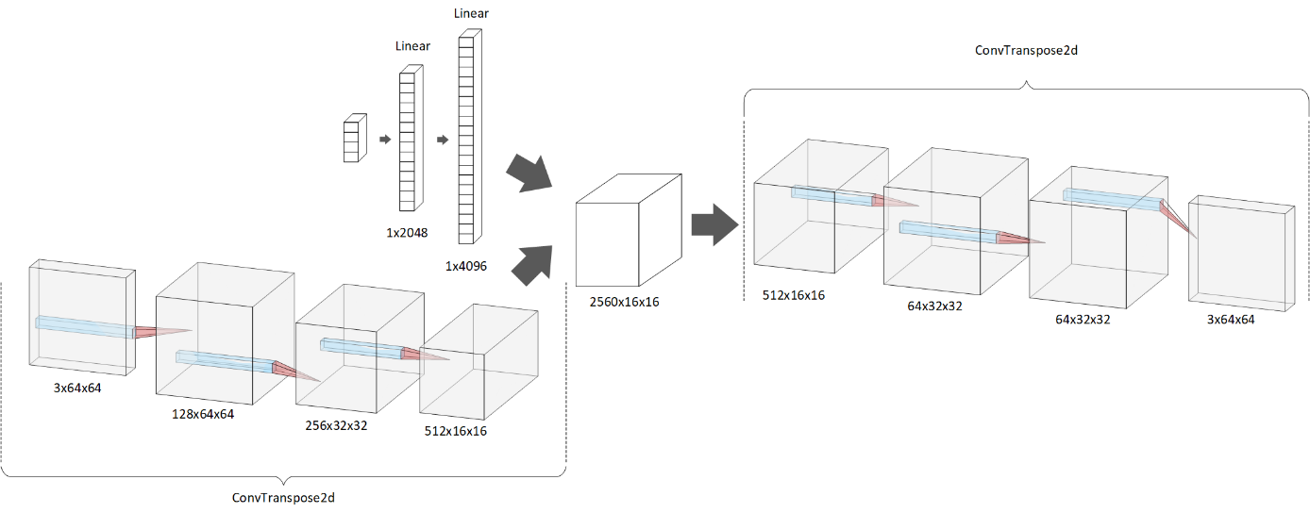
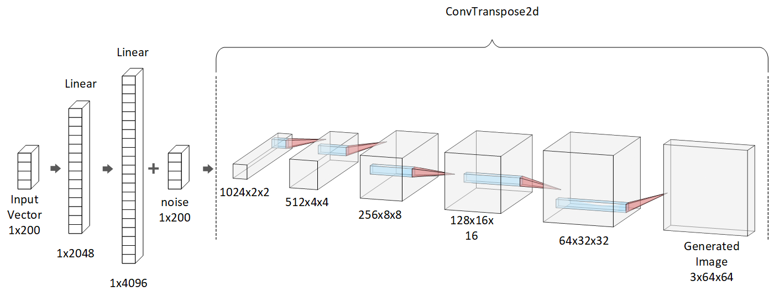
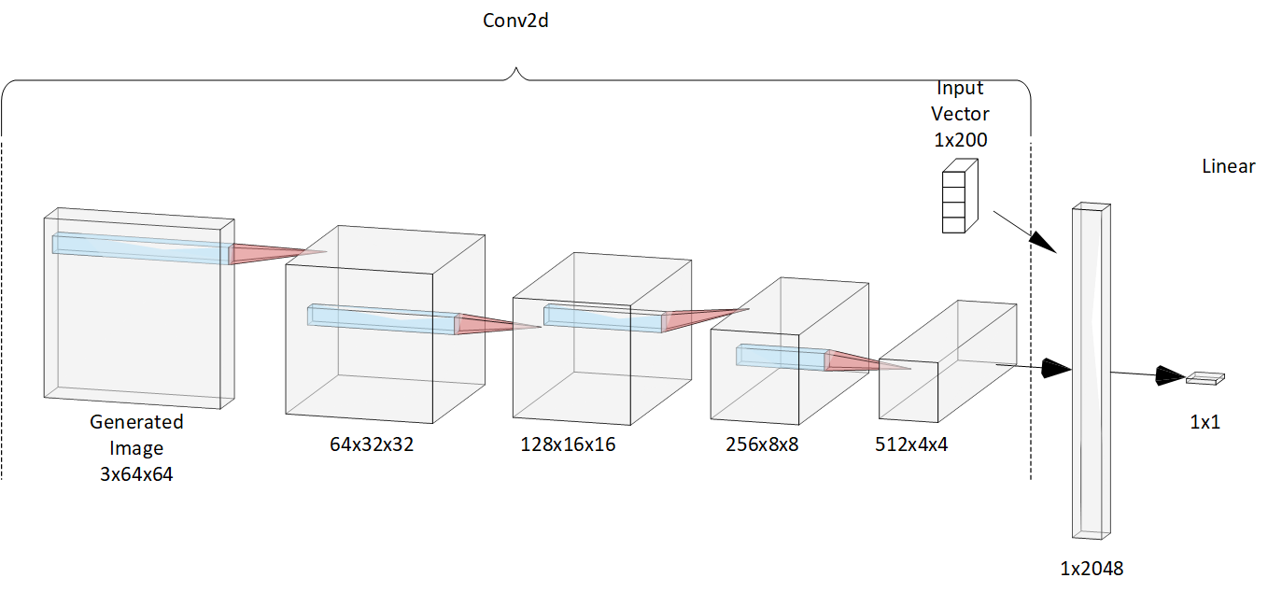
GAN Architecture
Stage I Generator
Stage II Generator
Stage I and II Discriminator

Slide 13
GAN Training Process
Generate Fake Data from Noise
Train the Discriminator on Real Data
1
2
Each Epoch
Train the Discriminator on Fake Data
Evaluate
5
3
4
Train the Generator through Discriminator Feedback

Slide 14
Results & Discussion

Slide 15
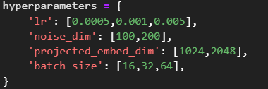
Hyperparameter Tuning Result
name | lr | noise dim | Proj_embd dim | Batch size | Fretchet dist | Inception score | Std score | Ssim score
Result1 | 0.0005 | 100 | 1024 | 16 | 1749.00 | 1.58 | 0.15 | 0.11
Result2 | 0.0005 | 100 | 1024 | 32 | 1522.52 | 1.55 | 0.18 | 0.15
Result3 | 0.0005 | 100 | 1024 | 64 | 1369.27 | 1.46 | 0.15 | 0.11
Result4 | 0.0005 | 100 | 2048 | 16 | 1564.74 | 1.45 | 0.14 | 0.16
Result5 | 0.0005 | 100 | 2048 | 32 | 1436.37 | 1.58 | 0.15 | 0.11
Result6 | 0.0005 | 100 | 2048 | 64 | 1408.64 | 1.51 | 0.15 | 0.12
Result7 | 0.0005 | 200 | 1024 | 16 | 1634.96 | 1.41 | 0.24 | 0.14
Result8 | 0.0005 | 200 | 1024 | 32 | 1474.93 | 1.53 | 0.15 | 0.13
Result9 | 0.0005 | 200 | 1024 | 64 | 1338.74 | 1.48 | 0.17 | 0.14
Result10 | 0.0005 | 200 | 2048 | 16 | 1621.00 | 1.52 | 0.09 | 0.11
Result11 | 0.0005 | 200 | 2048 | 32 | 1406.58 | 1.53 | 0.15 | 0.14
Result12 | 0.0005 | 200 | 2048 | 64 | 1254.15 | 1.44 | 0.14 | 0.13
Result13 | 0.001 | 100 | 1024 | 16 | 1701.52 | 1.50 | 0.18 | 0.15
Result14 | 0.001 | 100 | 1024 | 32 | 1464.06 | 1.59 | 0.13 | 0.13
Result15 | 0.001 | 100 | 1024 | 64 | 1342.28 | 1.42 | 0.13 | 0.13
Result16 | 0.001 | 100 | 2048 | 16 | 1612.73 | 1.43 | 0.14 | 0.14
Result17 | 0.001 | 100 | 2048 | 32 | 1326.29 | 1.43 | 0.13 | 0.12
Result18 | 0.001 | 100 | 2048 | 64 | 1277.16 | 1.43 | 0.14 | 0.13
Result19 | 0.001 | 200 | 1024 | 16 | 1543.70 | 1.47 | 0.22 | 0.15
Result20 | 0.001 | 200 | 1024 | 32 | 1521.37 | 1.52 | 0.18 | 0.13
Result21 | 0.001 | 200 | 1024 | 64 | 1343.98 | 1.53 | 0.19 | 0.13
Result22 | 0.001 | 200 | 2048 | 16 | 1678.64 | 1.43 | 0.10 | 0.17
Result23 | 0.001 | 200 | 2048 | 32 | 1419.68 | 1.53 | 0.17 | 0.15
Result24 | 0.001 | 200 | 2048 | 64 | 1318.94 | 1.42 | 0.13 | 0.15
Result25 | 0.005 | 100 | 1024 | 16 | 1457.36 | 1.52 | 0.13 | 0.09
Result26 | 0.005 | 100 | 1024 | 32 | 1460.39 | 1.53 | 0.17 | 0.12
Result27 | 0.005 | 100 | 1024 | 64 | 1366.39 | 1.49 | 0.18 | 0.13
Result28 | 0.005 | 100 | 2048 | 16 | 1499.43 | 1.53 | 0.20 | 0.12
Result29 | 0.005 | 100 | 2048 | 32 | 1599.96 | 1.60 | 0.21 | 0.12
Result30 | 0.005 | 100 | 2048 | 64 | 1319.99 | 1.54 | 0.19 | 0.14
Result31 | 0.005 | 200 | 1024 | 16 | 1649.25 | 1.44 | 0.07 | 0.10
Result32 | 0.005 | 200 | 1024 | 32 | 1414.05 | 1.44 | 0.21 | 0.17
Result33 | 0.005 | 200 | 1024 | 64 | 1261.21 | 1.46 | 0.19 | 0.15
Result34 | 0.005 | 200 | 2048 | 16 | 1585.14 | 1.42 | 0.17 | 0.18
Result35 | 0.005 | 200 | 2048 | 32 | 1353.95 | 1.53 | 0.20 | 0.16
Result36 | 0.005 | 200 | 2048 | 64 | 1386.6 9 | 1.48 | 0.15 | 0.12
Key Observations
A learning rate of 0.0005 seems to consistently produce better results than higher learning rates, indicating that smaller steps might be more effective in this case.
Increasing the noise dimensions generally leads to improved results, suggesting that richer representations are beneficial.
While there's some variation, larger batch sizes tend to perform slightly better than smaller ones, possibly due to increased stability during training.

Slide 16
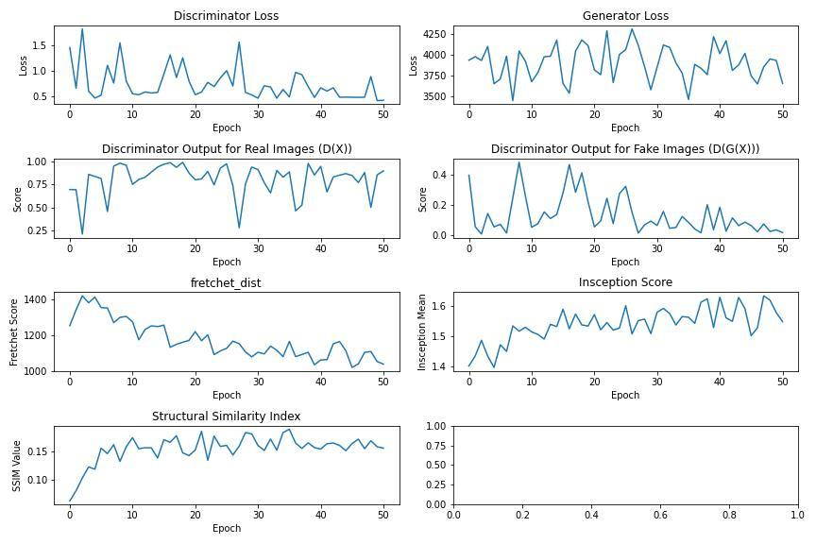
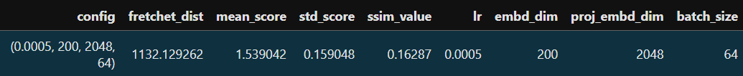
Quantitative Evaluation - Key Observations
The discriminator loss is decreasing, suggesting that the discriminator is improving.
The generator loss also is decreasing, indicating that the generator is generating more realistic images.
The discriminator output for real images is generally close to 1, and the output for fake images is generally close to 0, suggesting that the discriminator is performing well.
The FID is decreasing, suggesting that the model is improving.
The IS is increasing, suggesting that the model is improving.
The SSIM metric is increasing and after 400 epoch it flattens out, suggesting that the generated images are becoming more structurally similar to the real images.

Slide 17
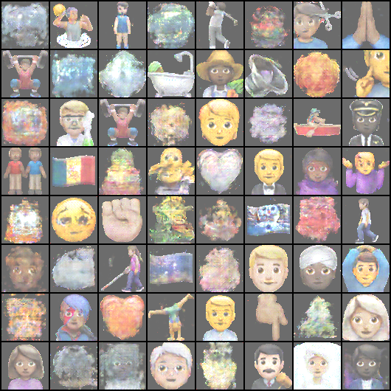
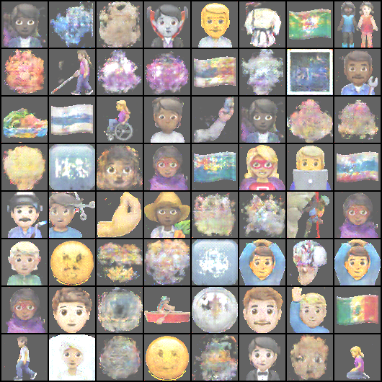
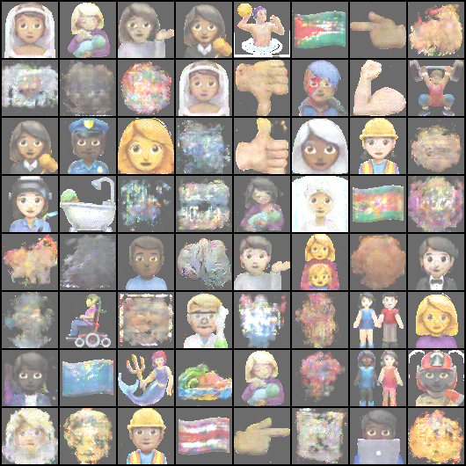
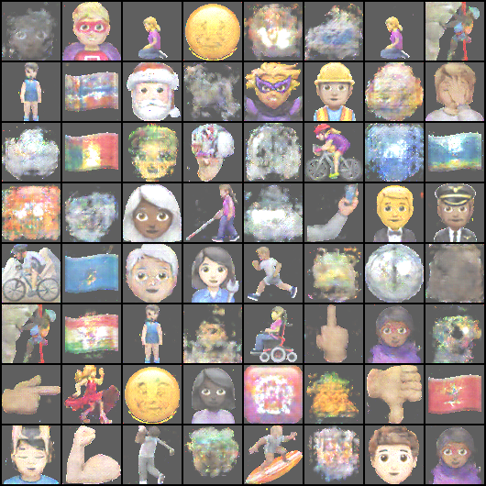
Qualitative Evaluation - Key Observations
We can see that the State II Generator visually performs better that the Stage I Generator results.
Some emojis, especially human figures and faces, are more recognizable but slightly distorted. This is common in GANs when the network is trained on a diverse dataset but hasn't fully learned fine details.
Background elements like cosmic or cloudy patterns.
Many human-like emojis like people biking, walking, wearing helmets show that the GAN is trying to capture movement and diverse activities,
The results while imperfect indicate a good generalize across these categories.

Slide 18
Conclusion and Future Recommendations

Slide 19
Conclusion
This thesis has successfully demonstrated the feasibility of generating high quality emojis using Stacked Generative Adversarial Networks (GANs). The proposed Stacked GAN architecture, combined with careful hyperparameter tuning, outperformed the baseline Stage I GAN model in terms of image quality and diversity.
The evaluation metrics employed in this study, FID, IS, and SSIM, provided valuable insights into the performance of both models. The Stacked GAN consistently achieved lower FID and higher IS scores, indicating a more diverse and higher-quality output. Additionally, the SSIM values demonstrated that the Stacked GAN generated images with better structural similarity to real emojis.
The performance of the Stacked GAN can be attributed to its growth mechanism and hierarchical feature learning. By starting with low-resolution images and gradually increasing the resolution, the Stacked GAN can effectively learn and capture complex patterns in the data. Furthermore, the hierarchical structure allows the model to focus on different levels of detail, leading to more realistic and expressive emojis.
Notes:
This study has shown that high-quality emoji generation is feasible using Stacked GANs. Stacked GAN architecture, coupled with hyperparameter optimization, surpassed the baseline Stage I GAN. The improvements are evident in both qualitative and quantitative metrics used.
Metrics like FID, IS, and SSIM were crucial for assessing model performance. Stacked GAN consistently outperformed the baseline model, with lower FID and higher IS, signaling superior quality of the emojis generated . The SSIM metric highlighted the structural similarity in Stacked GAN emojis compared to real emojis.
The Stacked GAN's incremental resolution growth and hierarchical learning were key contributors to its performance. Hierarchical feature learning enabled a focus on various detail levels, resulting in more realistic and expressive emojis.

Slide 20
Conclusion – Conti…
Hyperparameter tuning played a critical role in optimizing the performance of both models. By carefully selecting appropriate values for parameters like learning rate, projected embedding dimension, noise dimension and batch size the model was able to perform better. While the Stacked GAN demonstrated significant advantages in this study, there are still areas for future exploration.
In conclusion, this thesis has made a valuable contribution to the field of emoji generation by demonstrating the effectiveness of Stacked GANs. The findings of this research can be applied to various applications, such as social media platforms, messaging apps, and virtual reality experiences.
Notes:
Hyperparameter tuning was vital in optimizing the models.
Fine-tuning variables like learning rate, embedding dimensions, noise dimensions, and batch size boosted model performance.
This research has made a meaningful impact on emoji generation using Stacked GANs.
Some of the potential applications include social media platforms, messaging platforms, and virtual reality, where high-quality emojis enhance user experiences.

Slide 21
Future Recommendations
Due to limited computational resources, the GAN network in this study was trained on a partial subset of the emoji dataset. The limited training data somewhat limited the diversity and variety of the generated emojis, even though the model generated some good results based on this smaller dataset. We advise using the entire dataset to train the GAN in order to improve the model's performance even more and increase the variety of emojis it can generate.
Raising the image resolution of the pictures produced by the Stage II Generator to 128x128 pixels is one of the main suggestions for further research. It is anticipated that increasing the resolution at this point will greatly enhance the produced images' quality, sharpness, and detail.
A key recommendation for future work is to perform extensive hyperparameter tuning for the Stage II Generator to optimize its performance. Hyperparameters such as the learning rate, batch size, number of training epochs, dropout rate, and the architecture’s latent space dimensionality
Notes:
Training on full dataset
Increasing the resolution for stage 2 GAN
Hyperparameter tunning for stage 2

Slide 22
Thank You

